Slide 1
Statistical Models

Slide 2
Statistics for networks why?
All network analysis is based on statistics: So called “descriptive” or “summary” statistics that is
    Counts, sums, means, standard deviations, cumulative probability distributions, etc.
Sometimes we want to know whether what we observe is bigger or smaller than we would observe by chance (e.g. “inferential statistics”)
In a “standard” dataset:
  We would compute the summary statistic
  Make an assumption about how the statistic is distributed in the population (or in repeated observations)
  Compare the summary statistic to the expectation of the reference distribution
  Conclude that if our observation is more than two times a standard deviation bigger or smaller than it is “significantly” different

Slide 3
Statistics for networks why?
All network analysis is based on statistics: So called “descriptive” or “summary” statistics that is
    Counts, sums, means, standard deviations, cumulative probability distributions, etc.
Sometimes we want to know whether what we observe is bigger or smaller than we would observe by chance (e.g. “inferential statistics”)
In a “network” dataset:
  We know how to compute summary statistics
    Pretty much what “classical” network analysis was all about
  But the notion of a “distribution” of networks is not immediately intuitive
    What a lot of recent (e.g. post-2000s) network methodology has been all about

Slide 4
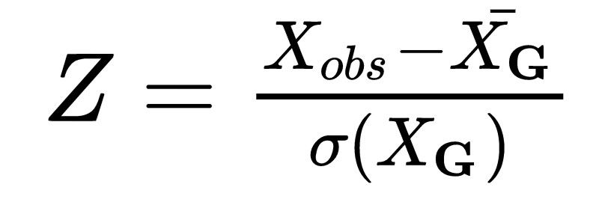
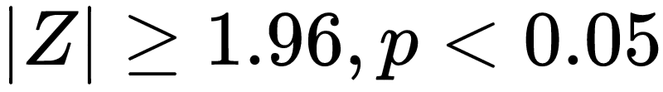
Statistics for networks why?
Our previous discussion of generative network models can help
  As you may recall, any generative network model produces a graph referred to as a realization: G(k)
  Multiple “runs” of the same model will produce a set of such realizations usually referred to as an ensemble:
    G = {G(k₁), G(k₁), G(k₁)...G(k_{n})}
This as a basis for doing some inferential statistics on networks
  Compute your summary statistics
  Generate a graph ensemble according to some generative model
  Compute the mean and standard deviation of the statistic in the ensemble:

Slide 5
Statistics for networks why?
We have already seen some generative network models that can be the basis of statistical inference
One way to think about generative models is about properties that the “fix” and properties that they let “vary”
  Erdos-Renyi (N, d):
    Fixes: N, d
      Where is N is number of nodes, d is network density
      Note that because E (number of edges) is a function of N and d:
        E = d(N * (N - 1))
      If N and d are fixed so is (expected) E
    Everything else is random

Slide 6
Statistics for networks why?
The Erdos-Renyi generative model is useful but sometimes we want to know whether there is something going above and beyond a more constraining set of “fixed” features of the the network
One of them is the degree distribution
  Very few “real” networks have the sort of normally distributed degrees predicted by Erdos-Renyi
The “configuration model” is useful for generative random graph ensembles that preserve a given distribution (actually a sequence) of degrees

Slide 7
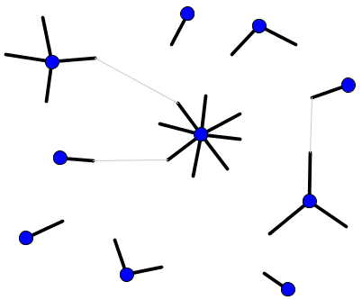
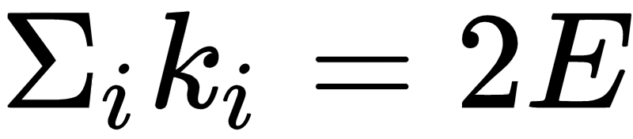
Statistics for networks why?
Configuration model
  Start with N number of nodes with “stubs” poking out from them
    Number of stubs corresponds to:
  Select two nodes (i,j) at random
    If each node has a “free” stub create an edge between i and j by joining the two stubs
  Continue until no more free stubs
    The resulting realization G(k) is a random graph with a degree distribution equal to the observed

Slide 8
Statistics for networks why?
Configuration model
  Start with N number of nodes with “stubs” poking out from them
    Number of stubs corresponds to:
  Select two nodes (i,j) at random
    If each node has a “free” stub create an edge between i and j by joining the two stubs
  Continue until no more free stubs
    You can the create an ensemble of such graphs and compute the Z-score for your summary stat

Slide 9
Statistics for networks why?
Quirks of configuration model
  Sum of degrees (number of stubs) must be an even number
    Otherwise one stub loses matching game
  Generates self-edges and multi-edges
    These can be ignored if the number of graphs in ensemble is large
  Topographically equivalent realizations are counted as different

Slide 10
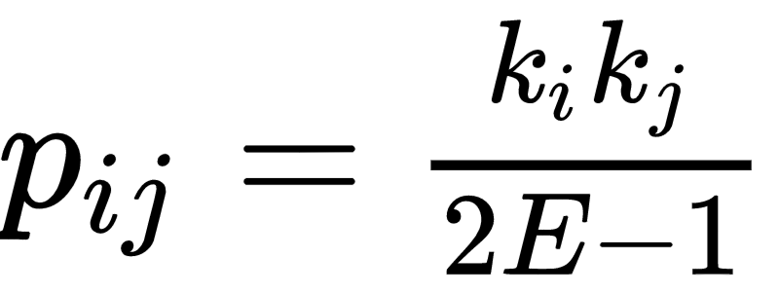
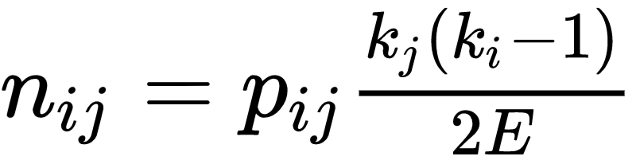
Statistics for networks why?
Properties of configuration model
  Probability of edge between two nodes
  Placeholder
  Placeholder
  Expected number of common neighbors:
  Placeholder
  Placeholder
  We can also define a generative configuration model by using p_{ij}
    Select two nodes at random
    Connect with probability:

Slide 11
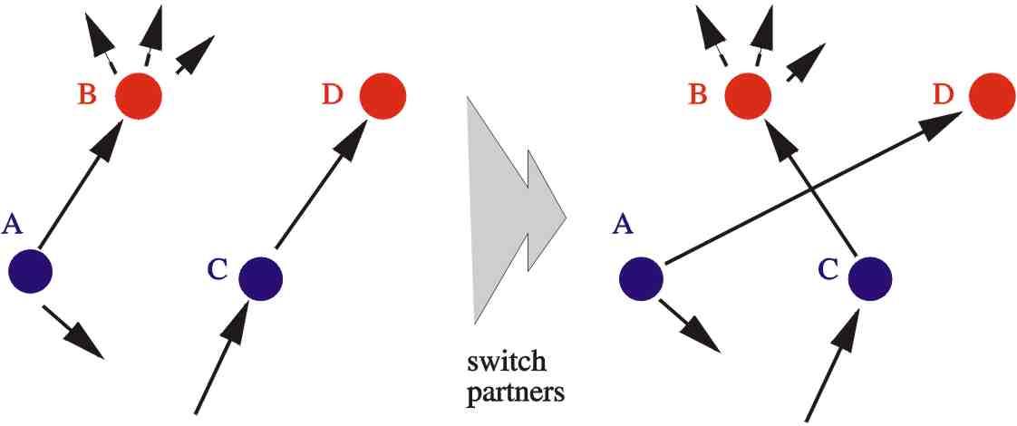
Statistics for networks why?
The Maslov-Sneppen “Rewiring” approach:
  Advantages over configuration:
    No need to worry about self, multi-edges
  Like configuration, preserves degree distribution (and every “lower” statistic) but randomizes everything else
Maslov, S. & Sneppen, K. Specificity and stability in topology of protein networks. Science 296, 910–913 (2002).

Slide 12
Statistics for networks why?
The Maslov-Sneppen “Rewiring” procedure:
  Pick two edges at random (e.g. ab and cd)
  Select a random node incident to each edge (e.g. b and d)
  Provided that the ad and the cb edges do not exist:
    Delete ab and cd, create ad and cb
Maslov, S. & Sneppen, K. Specificity and stability in topology of protein networks. Science 296, 910–913 (2002).

Slide 13
Statistics for networks why?
The Maslov-Sneppen “Rewiring” procedure:
  P_{ij} is still k_{i}k_{j}/(2E)
Useful for studying “excess” correlation between degrees in real world:
  N_{obs}( k_{i}k_{j}) versus Expected(N_{rand}( k_{i}k_{j}))
Maslov, S. & Sneppen, K. Specificity and stability in topology of protein networks. Science 296, 910–913 (2002).

Slide 14
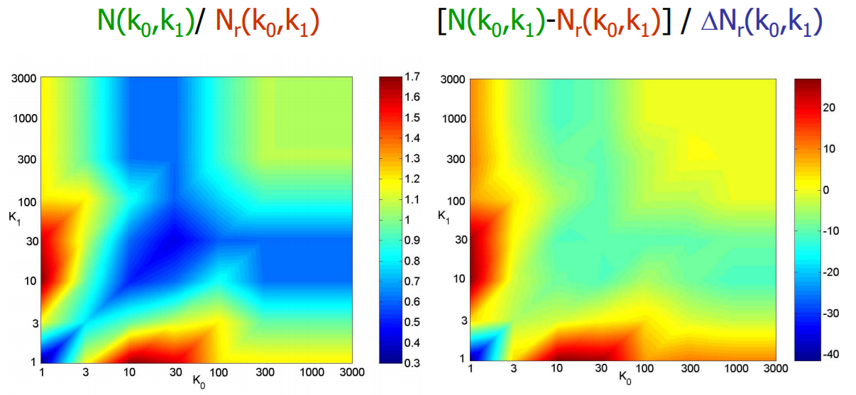
Statistics for networks why?
The Maslov-Sneppen “Rewiring” procedure:
  P_{ij} is still k_{i}k_{j}/(2E)
Useful for studying “excess” correlation between degrees in real world:
  N_{obs}( k_{i}k_{j}) versus Expected (N_{rand}( k_{i}k_{j}))

Slide 15
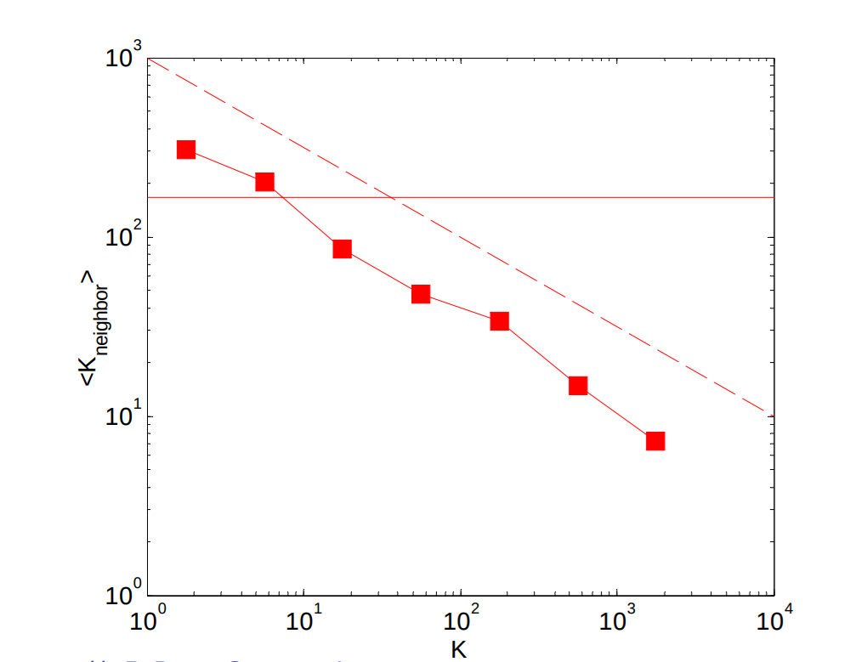
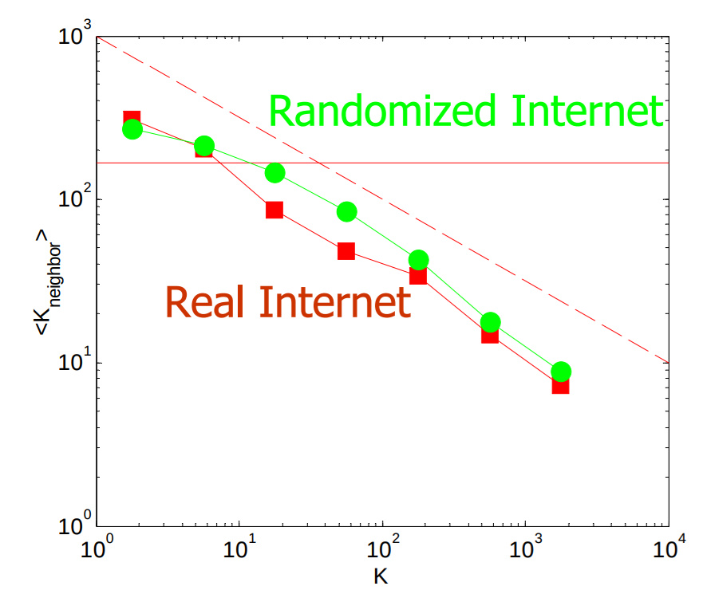
Statistics for networks why?
The Maslov-Sneppen “Rewiring” procedure:
  P_{ij} is still k_{i}k_{j}/(2E)
Substantive finding:
  The internet is not more “disassortative” than we would expect given the degree distribution

Slide 16
Statistics for networks why?
Orsini et al Quantifying Randomness
  Generative and rewiring models are all actually special cases of a more general approach
  We are interested in network properties (X) because we believe they are connected to function F (e.g. diffusion)
  But sometimes property X is correlated with property Y
    In statistics this raises the problem of confounding
    Maybe F is facilitated by Y and not X
  Generative models, rewiring, configuration, attempt to deal with this issue:
    Generate graph ensembles with property Y (Y-random graphs)
    See if Y and X are on average correlated in these graphs
      If so, spuriousness is an issue
      If not we don’t have to worry about it
    However there could be another set of properties Z₁, Z₂, Z₃,...etc.

Slide 17
Statistics for networks why?
Orsini et al Quantifying Randomness
  Solution:
    Rather than a single test against a single “null” model
    Create a hierarchical set of null-models ordered by the number of things that are fixed
    Every model defines an ensemble
    And every ensemble G(k_{n}) fixes all of the things as the previous ensemble G(k_{n-1}) plus one more higher order thing
      For instance a possible order would be:
        density -> degree distribution -> degree correlation
      The set of ensembles is the dk-series

Slide 18
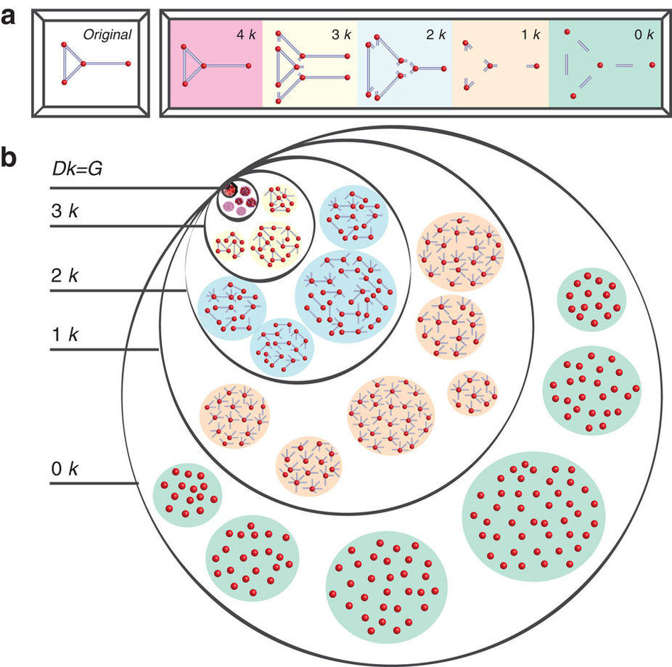
Statistics for networks why?
In this example:
  The 4k-distribution is the graph itself.
  The 3k-distribution consists of its three subgraphs of size 3:
  The 2k-distribution is the joint degree distribution in the graph.
    Number of links (subgraphs of size 2) connecting nodes of different degrees
  The 1k-distribution is the degree distribution in the graph.
  The 0k-distribution is just the average degree in the graph

Slide 19
Statistics for networks why?
A sequence of dk-distributions then defines a sequence of random graph ensembles
  The dk-graphs are a set of all graphs with a given dk-distribution:
    dk(0) = Erdos-Renyi
    dk(1) = Configuration, rewiring
    dk(2) = Random graphs with prescribed joint degree distribution, and so on

Slide 20
